Slide 1
Navigating the Deep Learning Framework Landscape A Comprehensive Exploration
Dr. Muhammad Sajjad
RA: Kaleem Ullah

Slide 2
Introduction - Pre-framework Era - Understanding Framework - Importance of Framework Deep Learning Frameworks - Overview - Advantages - Early Frameworks Key Frameworks - Theano: Research Revolution - Caffe: Vision Acceleration - Keras: Development Simplification - TensorFlow: Innovation Empowerment - MXNet: Scalable ML - Chainer: Advancements - PyTorch: Redefining Innovation - Microsoft Cognitive Toolkit (CNTK): AI Exploration Comparison and Analysis - TensorFlow: Origin, Features - Modeling: Sequential vs Functional APIs - TensorFlow vs Keras vs PyTorch - Overcoming Limitations
CONTENTS
Keras: Deep Dive
- Advantages
- Integration
- Creating Models
- Conventions
- Visualizing Models
- Tensor-Board Integration
PyTorch: In-depth
- Introduction
- Origin
- Tensors
- PyTorch vs TensorFlow
- Popularity
- Structure
- Useful Packages
- Visualization
Conclusion
- Summary
- Framework Selection
- Future Trends

Slide 3
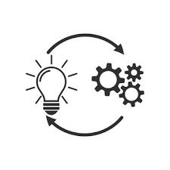

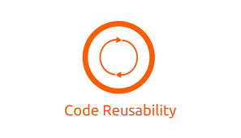


Pre-Framework Era
Manual Implementation
Custom Libraries
Limited Reusability
Developers crafted algorithms from scratch using languages like C, C++, or MATLAB.
Some created bespoke tools for specific tasks, lacking broad functionality.
Code reuse was minimal, leading to duplicated effort.
High Barrier to Entry
Lack of Standardization
Expertise in algorithms and programming languages was necessary.
Absence of common tools hindered collaboration and progress.

Slide 4







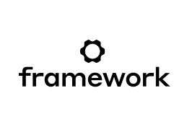
Framework
Definition
General vs Specialized
A structured set of concepts, practices, and tools for developing algorithms and applications in computer vision.
Can be general-purpose or tailored for specific tasks like object detection or medical imaging.
Components
Benefits
Includes pre-written code libraries, reusable components, and specialized APIs for image processing tasks.
Encourages clean, scalable code through standardized tools and best practices.
Purpose
Examples
Streamlines development by abstracting low-level image processing tasks, enabling faster prototyping.
OpenCV: Comprehensive library for image processing and computer vision. –
PyTorch: Flexible deep learning framework for implementing complex neural networks. –

Slide 5
Advantages of Deep Learning Frameworks
Efficiency
Community Support
Optimized implementations for faster computations.
Access to a large community for collaboration.
Abstraction
Flexibility
Simplifies model design and experimentation.
Allows for easy prototyping and customization.
Scalability
State-of-the-Art Models
Capable of handling large datasets and models.
Offers pre-trained models for various tasks.

Slide 6
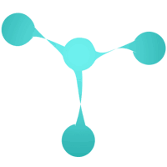
Torch: Forging the Path in Deep Learning Advancement
2002
Purpose
Enabling efficient and scalable symbolic mathematical computation.
Developed by
Pioneered by Ronan Collobert and his team at Facebook AI Research.
Target
Designed to empower deep learning research and development.
Key Feature
Distinguished by its flexible and modular design for neural network construction.
Performance
Renowned for its optimized implementation and efficient execution of computational graphs.

Slide 7
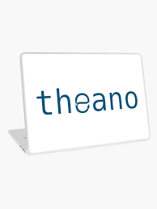
Theano: Revolutionizing Deep Learning Research
2007
Purpose
Facilitating efficient and scalable symbolic mathematical computation.
Developed by
Led by Yoshua Bengio and a pioneering team at Université de Montréal.
Target
Dedicated to enabling and enhancing deep learning research endeavors.
Key Feature
Offering advanced automatic differentiation for seamless neural network training.
Performance
Achieving unparalleled speed and efficiency through meticulous code compilation.

Slide 8
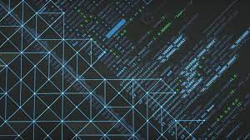
OpenNN: Elevating Deep Learning Exploration
2009
Purpose
Enabling efficient and scalable symbolic mathematical computation.
Developed by
Spearheaded by a visionary team led by [developer's name].
Target
Tailored to empower and elevate deep learning research initiatives.
Key Feature
Providing advanced automatic differentiation capabilities for streamlined neural network training.
Performance
Delivering unmatched speed and efficiency through rigorous code optimization.

Slide 9
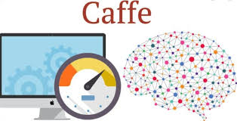
Caffe: Accelerating Computer Vision Innovation
2013
Purpose
Powering efficient and scalable deep learning model development.
Developed by
Led by Yoshua Bengio and a pioneering team at Université de Montréal.
Target
Tailored for accelerating research and development in computer vision.
Key Feature
Robust support for designing and training convolutional neural networks.
Performance
Delivering high-speed processing through optimized GPU utilization.

Slide 10
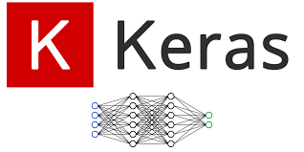
Keras: Simplifying Deep Learning Development
2015
Purpose
Facilitating streamlined and scalable development of deep learning models.
Developed by
Spearheaded by François Chollet as part of the TensorFlow project.
Target
Geared towards simplifying the implementation and experimentation of deep learning concepts.
Key Feature
Providing a user-friendly interface and abstraction layer for neural network construction.
Performance
Ensuring flexibility and performance with seamless integration with TensorFlow backend.

Slide 11

TensorFlow: Empowering Deep Learning Innovation
2015
Purpose
Enabling highly efficient and scalable symbolic mathematical computation.
Developed by
Spearheaded by the Google Brain team led by Jeff Dean and Rajat Monga.
Target
Focused on empowering and advancing deep learning research and applications.
Key Feature
Providing cutting-edge automatic differentiation for seamless and robust neural network training.
Performance
Achieving exceptional speed and efficiency through meticulously optimized code compilation.

Slide 12
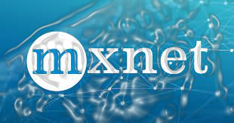
MXNet: Empowering Scalable Machine Learning Innovations
Purpose
2015
Enabling efficient and scalable symbolic mathematical computation for machine learning tasks.
Developed by
Collaboratively developed by researchers from multiple institutions including the University of Washington and Carnegie Mellon University.
Target
Geared towards facilitating cutting-edge research and practical applications in deep learning.
Key Feature
Notable for its flexible programming interface and support for distributed computing, enhancing scalability and performance.
Performance
Demonstrating exceptional speed and efficiency, particularly in distributed computing environments, due to its optimized code compilation.

Slide 13

Chainer: Revolutionizing Deep Learning
2015
Purpose
Empowering efficient and scalable symbolic mathematical computations.
Developed by
Spearheaded by a visionary team, including Seiya Tokui, at Preferred Networks.
Target
Geared towards facilitating and elevating deep learning research and development.
Key Feature
Introducing innovative dynamic computation graph for agile neural network training.
Performance
Delivering exceptional speed and efficacy via rigorous code optimization.

Slide 14

PyTorch: Redefining Deep Learning Innovation
2016
Purpose
Empowering efficient and scalable symbolic computation for neural networks.
Developed by
Spearheaded by a pioneering team led by researchers at Facebook AI.
Target
Aimed at revolutionizing deep learning research and application development.
Key Feature
Introducing dynamic computation graph for flexible model design and debugging.
Performance
Delivering superior speed and efficiency through optimized tensor computations.

Slide 15
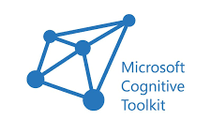
Microsoft Cognitive Toolkit (CNTK): Empowering AI Exploration
2016
Purpose
Empowering efficient and scalable symbolic mathematical computation.
Developed by
Spearheaded by a visionary team at Microsoft Research.
Target
Committed to empowering and elevating deep learning research initiatives.
Key Feature
Providing cutting-edge automatic differentiation for seamless neural network training.
Performance
Attaining unmatched speed and efficiency via rigorous code compilation.

Slide 16

TenserFlow
Origins
Development
Significance
TensorFlow was developed in November 2015 by a team of researchers and engineers at Google's Brain team.
It was created to meet the increasing need for a flexible and scalable open-source machine learning framework.
The motivation behind TensorFlow's creation was to provide a platform that could facilitate the development and deployment of machine learning models across various domains and applications.
The development of TensorFlow was led by the Google Brain team, comprising experts in machine learning, software engineering, and data science.
Visionaries like Jeff Dean and Rajat Monga played key roles in spearheading the project.
The team's collaborative efforts resulted in the release of TensorFlow, which quickly gained traction and became one of the most widely used machine learning frameworks globally.
TensorFlow revolutionized the field of artificial intelligence by offering extensive support for deep learning and neural networks.
It empowered researchers and developers with a powerful tool for building and deploying cutting-edge machine learning models efficiently.
TensorFlow's inception marked a significant milestone in the advancement of machine learning, laying the groundwork for numerous innovations and advancements in AI and related fields.

Slide 17

Modeling
The Functional API offers a flexible and powerful approach for building neural networks, ideal for complex architectures and advanced functionalities.
It enables the creation of models with multiple input and output layers, shared layers, and branched architectures.
This method is preferred for constructing models with intricate connections and non-linear network structures.
Sequential API
Functional API
The Sequential API offers a simple and intuitive approach for building neural networks, particularly suited for beginners and standard architectures.
It enables you to construct models layer by layer in a linear fashion, with each layer feeding its output to the next layer.
This method is well-suited for creating straightforward architectures, including feedforward neural networks and convolutional neural networks (CNNs).
Input
Input
Layer
Layer
Layer
Layer
Output
Output

Slide 18
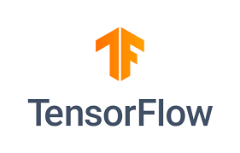

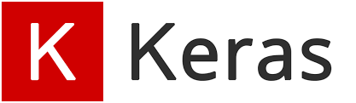
TensorFlow vs Keras
TensorFlow
Keras
TensorFlow is a comprehensive open-source machine learning framework developed by Google.
It provides a wide range of tools and functionalities for building, training, and deploying machine learning models.
TensorFlow offers flexibility and scalability, catering to various applications, from research to production deployment.
It allows for low-level control over model architecture and optimization, ideal for advanced users and complex projects.
TensorFlow supports not only neural networks but also other machine learning algorithms and techniques.
Keras is a high-level neural networks API, initially developed independently.
It offers a user-friendly interface for building and training neural networks with minimal code.
Emphasizing simplicity and ease of use, Keras is ideal for beginners and rapid prototyping.
Although Keras can be used independently, it has been integrated into TensorFlow as its official API since TensorFlow version 2.0.
Within TensorFlow, Keras maintains its user-friendly features while harnessing TensorFlow's scalability and performance.

Slide 19

TensorFlow vs PyTorch
TensorFlow
PyTorch
TensorFlow, developed by Google, is a robust and flexible open-source machine learning framework.
It provides extensive support for deep learning and neural networks, offering a diverse array of pre-built models and tools.
TensorFlow is renowned for its scalability and readiness for production deployment, making it a popular choice in both research and industry.
Utilizing a static computational graph, TensorFlow defines the graph structure before execution, enabling optimizations like graph compilation and distributed execution.
Developed by Facebook's AI Research lab, PyTorch is a dynamic deep learning framework celebrated for its simplicity and flexibility.
PyTorch boasts a dynamic computational graph, facilitating intuitive model building and debugging.
Favored by researchers and academics for its ease of use and robust support for dynamic computation, PyTorch excels in experimentation and research projects.
PyTorch's imperative programming style enables easy debugging and experimentation, allowing models to be built and modified on the fly.

Slide 20
Features
1
Responsive Construct
Efficient execution across hardware platforms.
2
Flexible
Allows custom neural network architectures.
3
Easily Trainable
Simplifies model training with high-level APIs.
4
Parallel Training
Supports distributed training for speed.
5
Open Source
Accessible source code for customization.

Slide 21
Continue
6
Feature Columns
Tools for preprocessing structured data.
7
Layered Components
Modular architecture for flexibility.
8
Statistical Distributions
Includes various distributions for modeling uncertainty.
9
Layered components
Modular architecture for flexibility.
Visualizer (with Tensorboard)
Visualization tool for monitoring models.

Slide 22
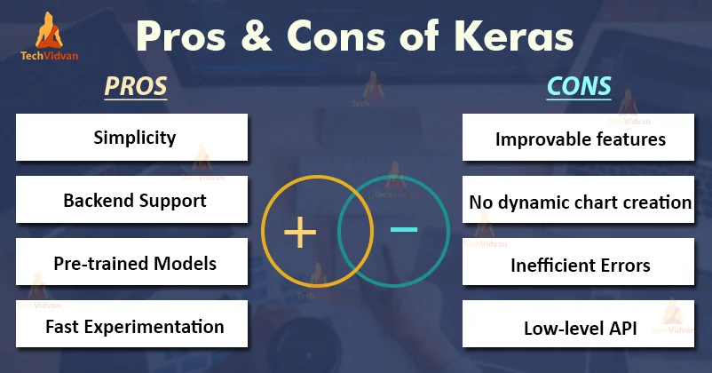

Overcoming Framework Limitations with Keras
Keras resolved limitations in flexibility and customization of earlier frameworks.
Provided a high-level, user-friendly API for building neural networks.
Streamlined development process for rapid prototyping and experimentation.
Islamia College,
Peshawar

Slide 23
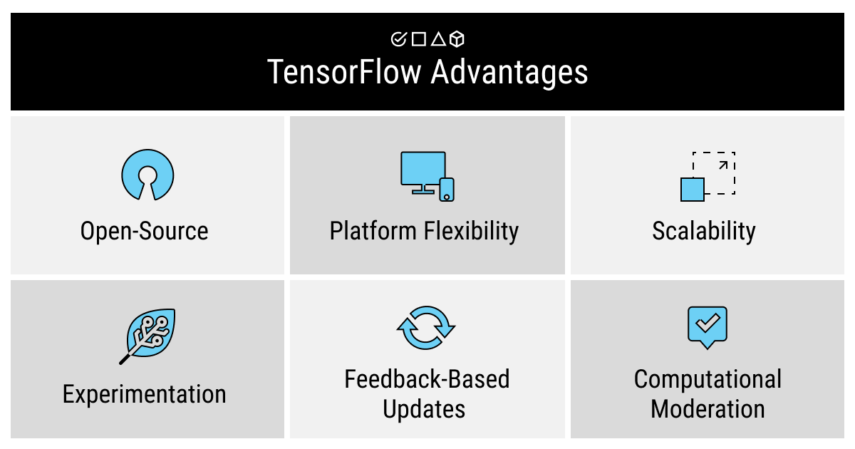
Overcoming Framework Limitations with TensorFlow
TensorFlow addressed challenges of complex API and steep learning curve.
Introduction of higher-level APIs like Keras enhanced accessibility.
Improved productivity in building and deploying deep learning models.
Islamia College,
Peshawar

Slide 24
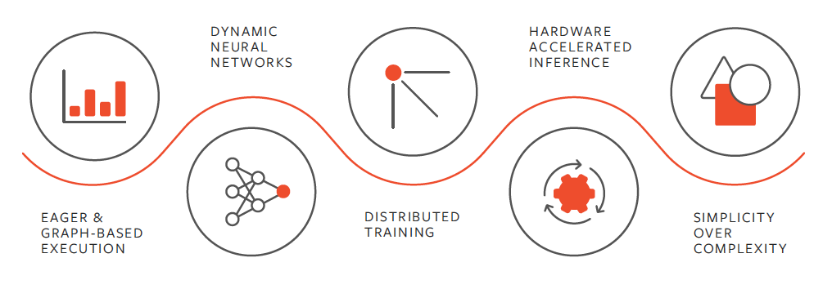
Overcoming Framework Limitations with PyTorch
Dynamic computational graphs.
Can make use of standard Python flow control.
Support for Python debuggers.
It is liked in research area.
Might not be as efficient as TensorFlow for large training tasks.
Islamia College,
Peshawar

Slide 25
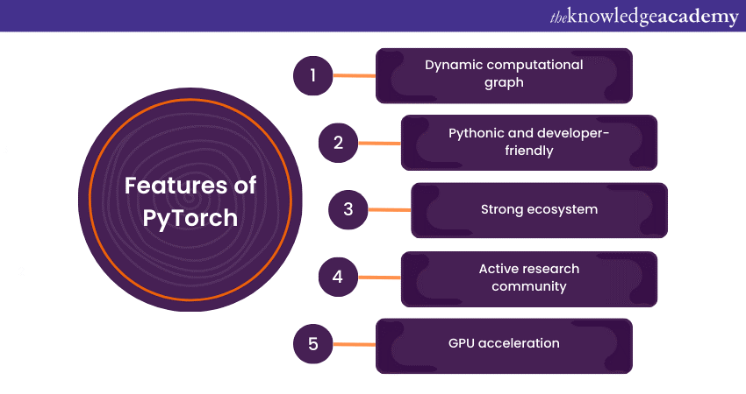
PyTorch: The Choice of Researchers
Islamia College, Peshawar
Notes:
CNTK (Microsoft Cognitive Toolkit)

Slide 26
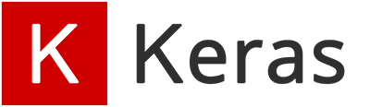
Keras is an open-source deep learning framework primarily designed for fast experimentation and prototyping of neural networks.
It is a high-level neural networks API written in Python, facilitating easy construction, training, and deployment of neural networks, and compatible with TensorFlow, CNTK, or Theano.
It can be run on both CPU and GPU.
It was developed by François Chollet and first released in March 2015.
Islamia College,
Peshawar
Notes:
CNTK (Microsoft Cognitive Toolkit)

Slide 27
Advantages of Keras
Keras offered unique advantages, setting it apart from other frameworks, such as:
Simplicity and Ease of Use
Minimal boilerplate code for quick prototyping.
Extensive Backend Support:
Compatible with multiple backend engines such as TensorFlow etc.
Offers flexibility to choose backend based on project requirements and preferences.
Islamia College,
Peshawar

Slide 28
Modularity and Flexibility
Modular design facilitates construction of complex architectures.
Encourages experimentation with different network configurations.
High-Level Abstractions
Provides intuitive abstractions for common deep learning tasks.
Simplifies implementation of complex algorithms.
Community and Ecosystem
Keras has been open-source since its initial release
Large and active community of users and contributors.
Rich ecosystem of libraries, tools, and resources for support and extension.
Islamia College,
Peshawar

Slide 29
Integration of Keras into TensorFlow
Google's deep learning framework TensorFlow integrated Keras into its core library in 2017.
Keras was developed and is maintained by Francois Chollet and is part of the Tensorflow core, which makes it Tensorflow’s preferred high-level API.
This integration enabled users to utilize Keras as a high-level interface.
Users could leverage TensorFlow's powerful features as the backend.
Latest versions: TensorFlow: tensorflow 2.16. 1, Keras keras 3.3
Now we can import keras either as standalone or as part of TensorFlow
import keras
from tensorflow import keras
Islamia College,
Peshawar

Slide 30
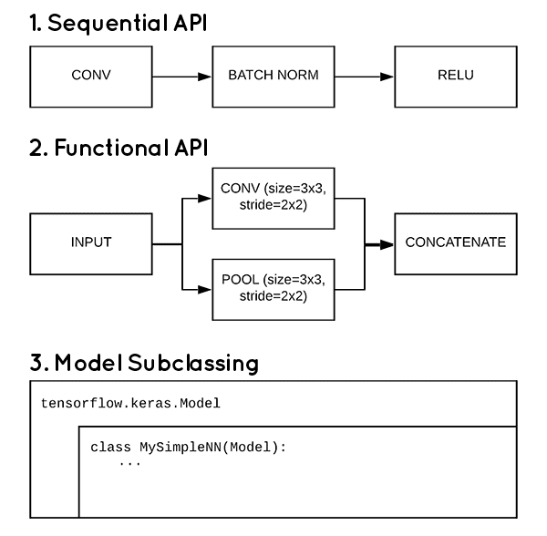
Creating models in Keras:
Sequential Model:
Simplest way to create a model in Keras, where layers are added sequentially.
Suitable for most simple architectures such as feedforward neural networks and convolutional neural networks (CNN)
The problem with the sequential API is that it doesn’t allow models to have multiple inputs or outputs, which are needed for some problems.
# Define Sequential model with 3 layers
model = keras.Sequential(
[
layers.Dense(2, activation="relu", name="layer1"),
layers.Dense(3, activation="relu", name="layer2"),
layers.Dense(4, name="layer3"),
]
)
Islamia College,
Peshawar

Slide 31
Functional API:
It allows for more flexibility in model architectures.
It enables the creation of complex models with multiple inputs, multiple outputs, shared layers, and branching topologies.
# Define input layer
inputs = Input(shape=(input_shape,))
# Define layers
layer1 = Dense(2, activation="relu", name="layer1")(inputs)
layer2 = Dense(3, activation="relu", name="layer2")(layer1)
layer3 = Dense(4, name="layer3")(layer2)
# Define output
outputs = layer3
# Create functional model
model = Model(inputs=inputs, outputs=outputs)
Islamia College,
Peshawar

Slide 32
Conventions in Keras
The conventions ensure consistency and readability in code, facilitating collaboration and maintenance.
1. Sequential Naming:
Layers named sequentially (e.g., layer1, layer2) for easy identification.
2. Meaningful Layer Names:
Give layers meaningful names using the name parameter (e.g., dense_layer1).
3. Consistent Activation Functions:
Use consistent activation functions throughout the model for coherence.
4. Variable Naming:
Use descriptive variable names to indicate their purpose (e.g., input_data, learning_rate)
5. Clear Documentation:
Include comments and docstrings for clear documentation of functions and code blocks.
Islamia College,
Peshawar

Slide 33


Comparisons:
Keras vs TensorFlow
Keras:
Utilizes static computational graphs.
Focuses on simplicity and ease of use.
High-level abstraction for rapid prototyping.
Ideal for quick experimentation and model iteration.
TensorFlow:
Offers both static and dynamic computational graphs.
Provides extensive control and flexibility.
Widely adopted for production-level deployment.
Known for scalability and performance in complex tasks.
Islamia College,
Peshawar

Slide 34

Keras vs PyTorch:
Keras
Utilizes static computational graphs.
Limited use of standard Python flow control.
Limited support for Python debuggers.
Popular in industry and academia.
Known for efficiency in large-scale training tasks.
PyTorch
Dynamic computational graphs.
Can make use of standard Python flow control.
Support for Python debuggers.
It is liked in research area.
Might not be as efficient as TensorFlow for large training tasks.
Islamia College,
Peshawar

Slide 35
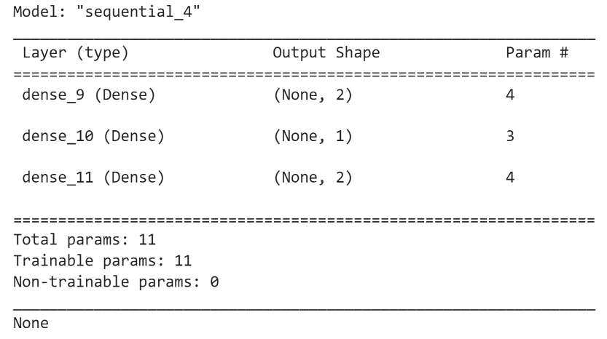
Visualizing Models in Keras
Model Summary: summary()
Provides a concise overview of model architecture.
Displays layer types, shapes, and total parameters.
Plotting Model Architectures:
Utilizes tools like plot_model.
Generates graphical representations of neural network flow.
Visualizing Training History:
Utilizes Matplotlib to track metrics over epochs.
Monitors training progress and model performance.
Islamia College,
Peshawar

Slide 36
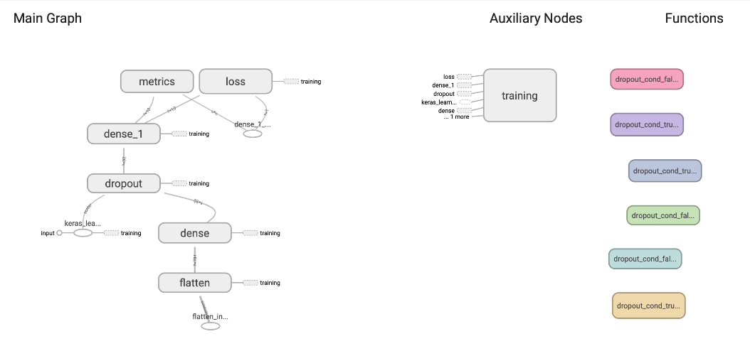
TensorBoard Integration:
Smoothly integrates with TensorBoard.
Captures different metrics and model designs during training.
Islamia College,
Peshawar

Slide 37

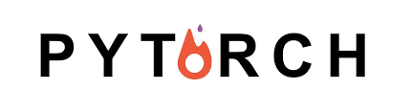


What is PyTorch?
PyTorch is a deep learning framework for building neural networks used in various domains such as computer vision and natural language processing.
Developed by Facebook's AI Research lab (FAIR)
Released in October 2016 as an open-source project
Popular among researchers and practitioners in the deep learning community.
Used by large companies like Meta, Tesla, Uber, and Nvidia.

Slide 38


Origin of PyTorch
PyTorch originated from Torch, a scientific computing framework and machine learning library written in Lua programming language.
What Torch Provided?
Provided efficient numerical computations and tensor operations.
Provided dynamic computation graphs, enabling researchers to experiment quickly.
Built on a C/C++ core, offering speed and efficiency.
What Torch Lacked?
Strong integration with Python, which was becoming the de-facto language for machine learning.
Torch had a steeper learning curve due to its Lua-based syntax.
Its API was not user-friendly.

Slide 39
Origin of PyTorch
The existing frameworks which were popular for deep learning, like TensorFlow, have limitations.
Static computation graph doesn’t allow for explicit data movement.
Thus less control over low level operations.
The API was not user friendly (or Pythonic).

Slide 40
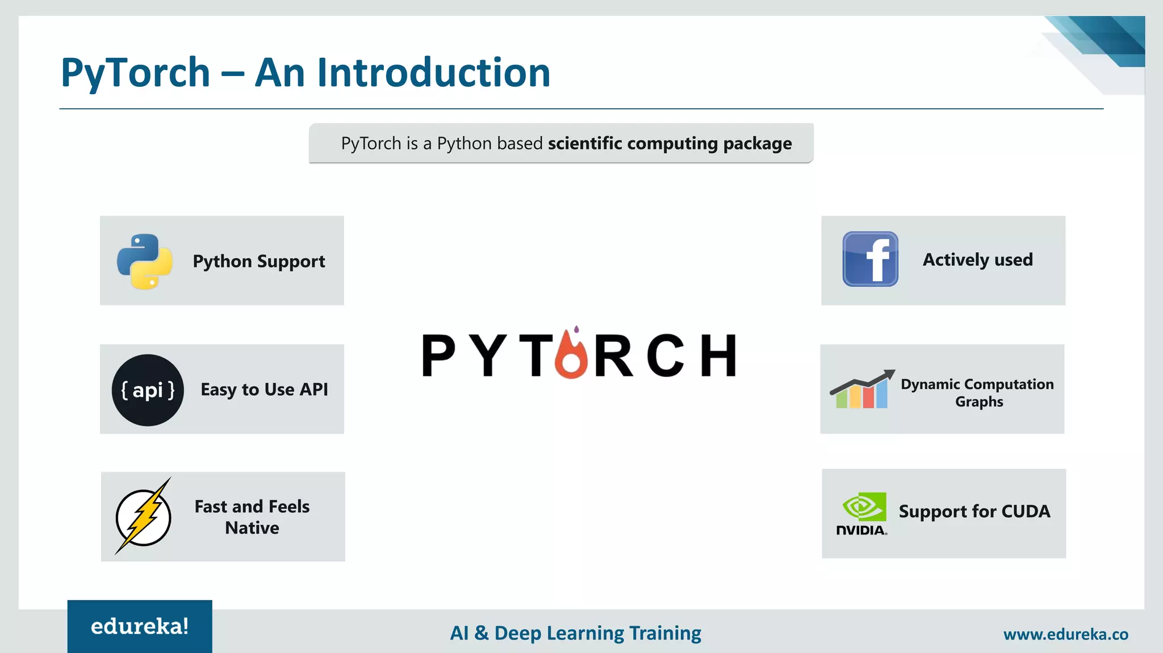
Origin of PyTorch
To address these limitations, PyTorch was created.
PyTorch Provided:
a Python API to leverage Torch capabilities.
Tensor operations that are heavily inspired by NumPy.
Autograd engine for efficient computation of gradients in neural networks.
Integration with CUDA, enabling GPU acceleration

Slide 41
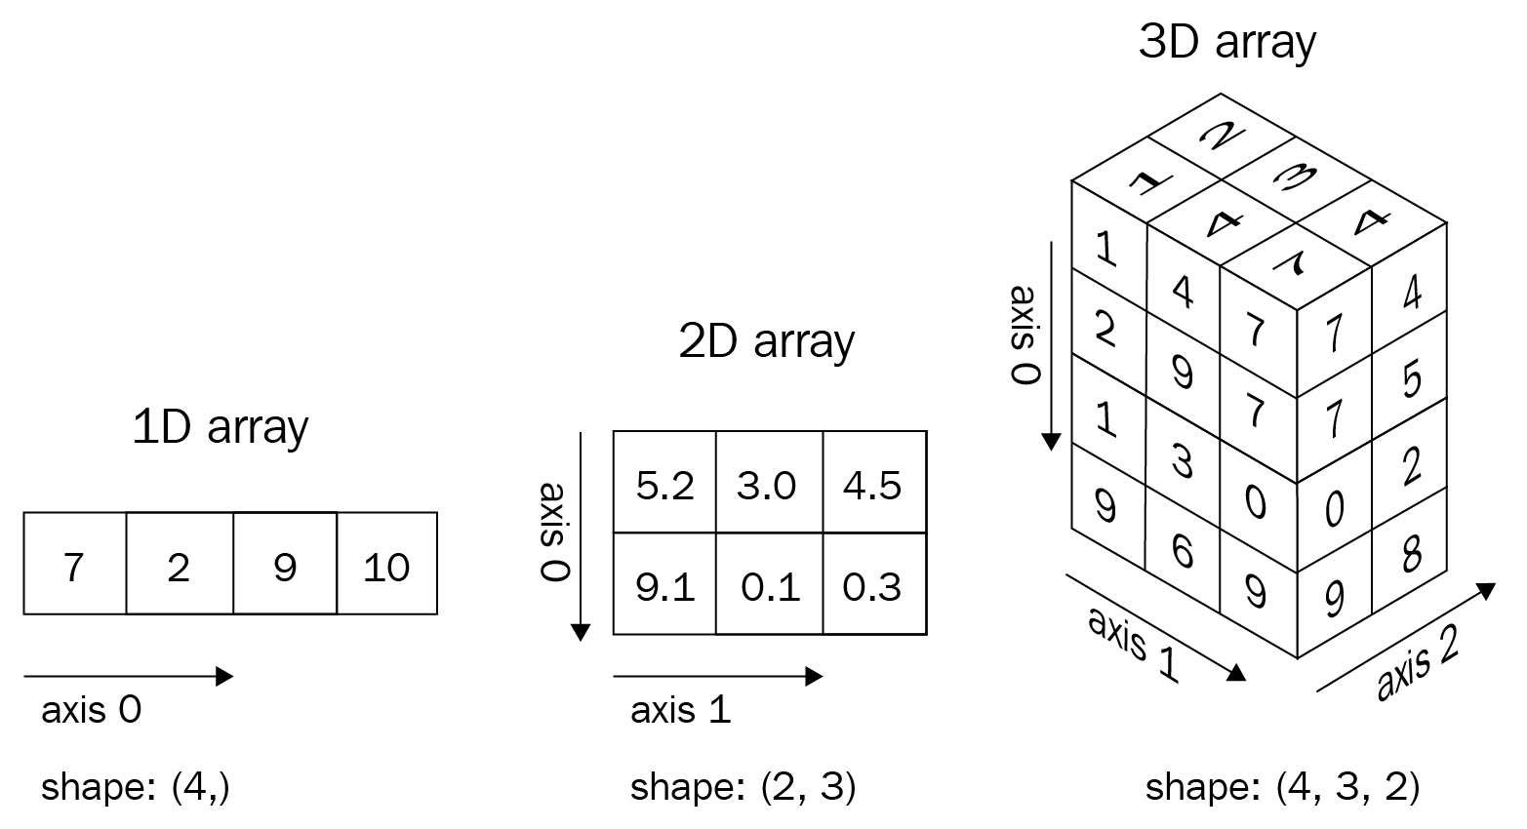
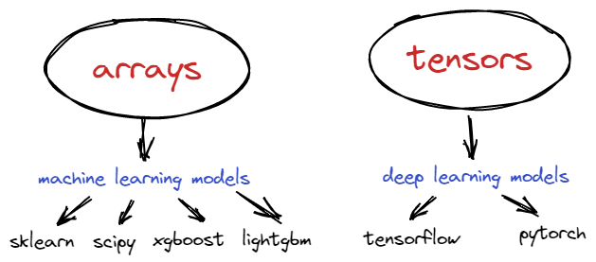
PyTorch Tensors
PyTorch tensors are the fundamental building blocks for deep learning tasks. The are similar to NumPy arrays with additional features.
PyTorch Tensors
Can reside on GPUs for faster computations.
Support automatic differentiation to compute gradients during training.
Operations that are supported are very similar to NumPy arrays but are faster.

Slide 42
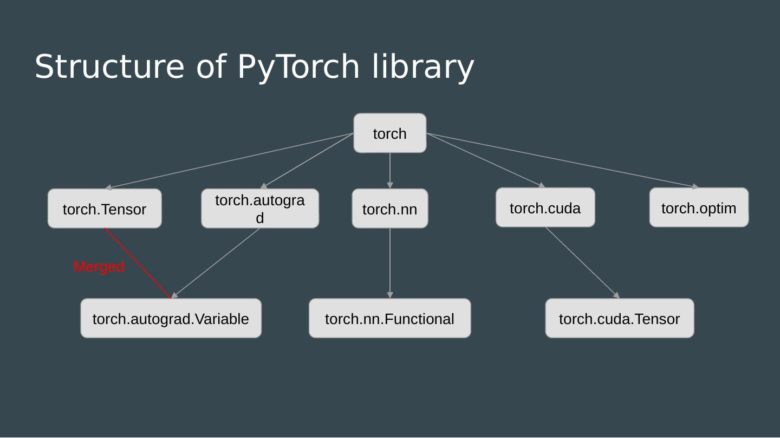
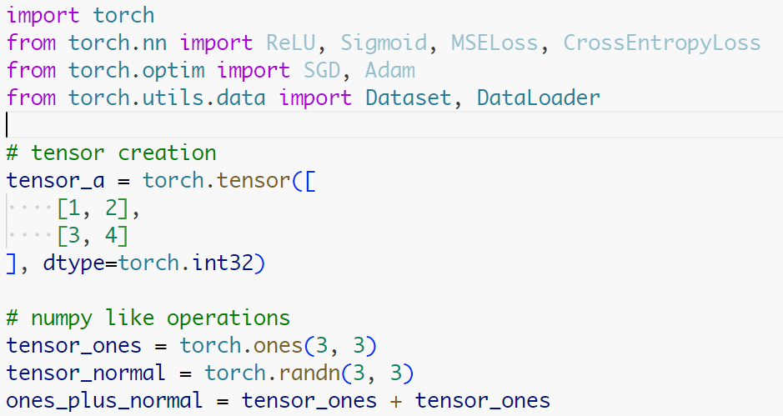
Structure of PyTorch Library
PyTorch provides several modules for deep learning tasks, from loading data to defining layers and choosing optimizers.
PyTorch Modules
torch: the main module that provides tensors and operations on them.
torch.nn: includes classes and functions to define layers, loss functions and activation functions.
torch.optim: provides optimization algorithms for training (SGD, ADAM, etc)
torch.utils.data: provides functionalities for loading datasets and creating batches during training

Slide 43
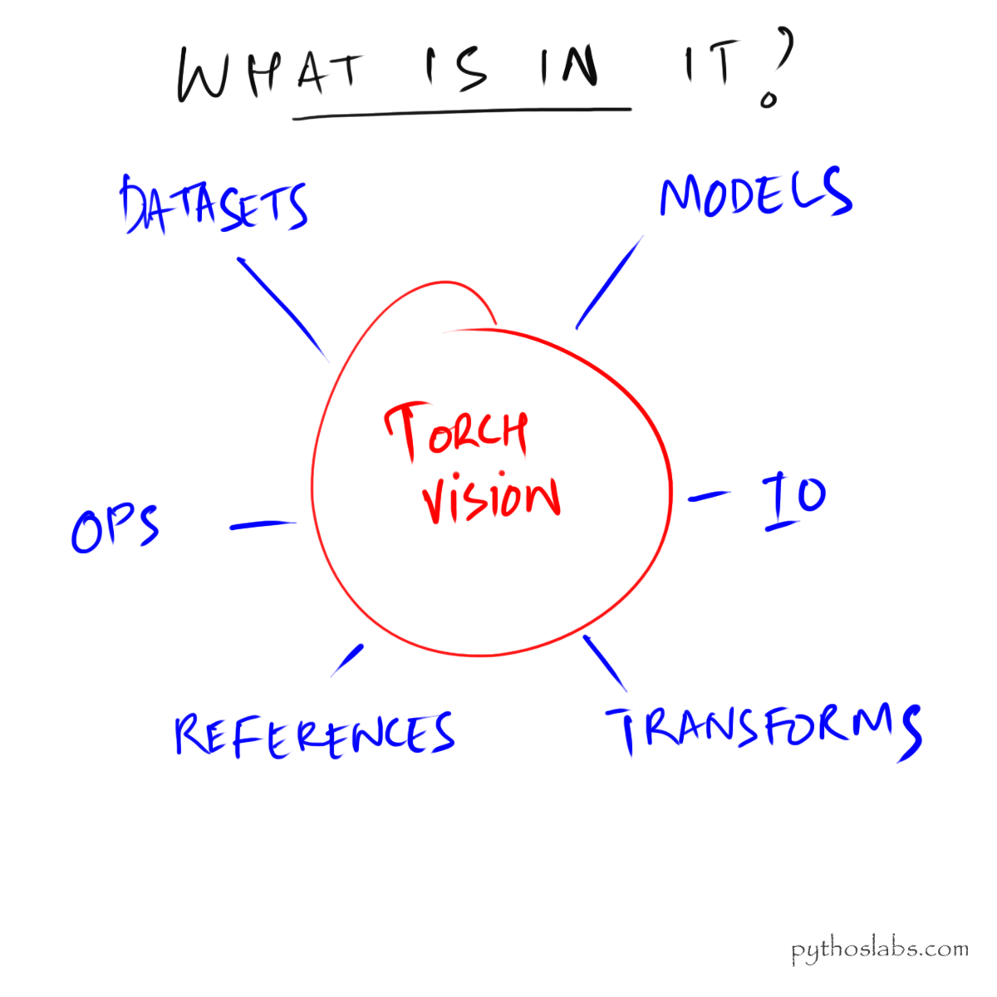

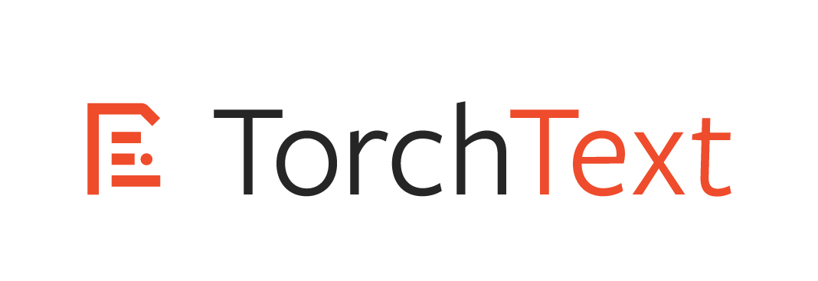
Useful PyTorch Packages
PyTorch provides several other package that are specifically designed for tasks such as computer vision, NLP, audio processing, etc.
“torchvision” provides
Access to popular computer vision datasets, pretrained models, and preprocessing.
“Torchaudio” provides
Utilities for loading and preprocessing audio data.
Datasets and pretrained models for speech recognition and sound classification.
“torchtext” provides
Utilities for loading and preprocessing text data for NLP tasks.
Datasets, tokenizers and pretrained word embeddings.

Slide 44
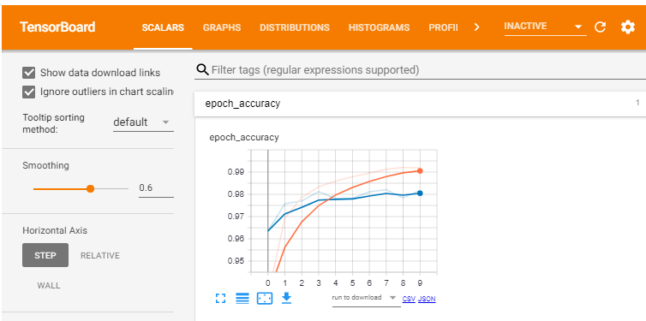
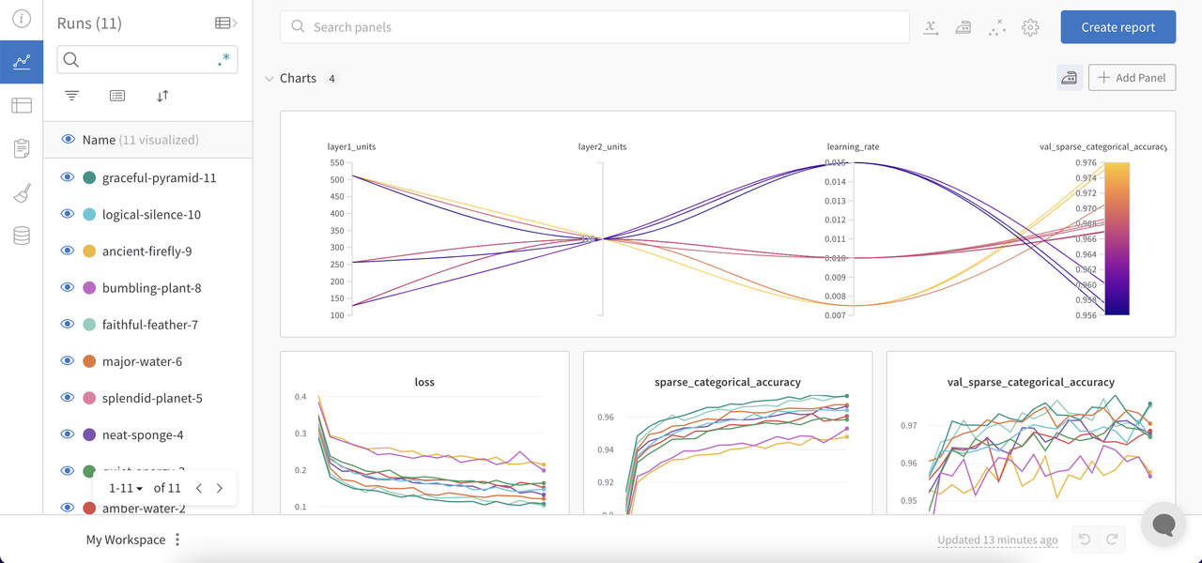
Visualization and Experiment Tracking
PyTorch integrates well with several popular logging tools for logging the training process and make visualization, such as:
TensorBoard
TensorFlow TensorBoard is compatible with PyTorch via the `tensorboardX` that is used to visualize training metrics like loss, accuracy, f1 score, etc.
Weights and Biases, Neptune.ai
It is a cloud platform that provides tools for experiment tracking, versioning, visualization, and collaboration.

Slide 45
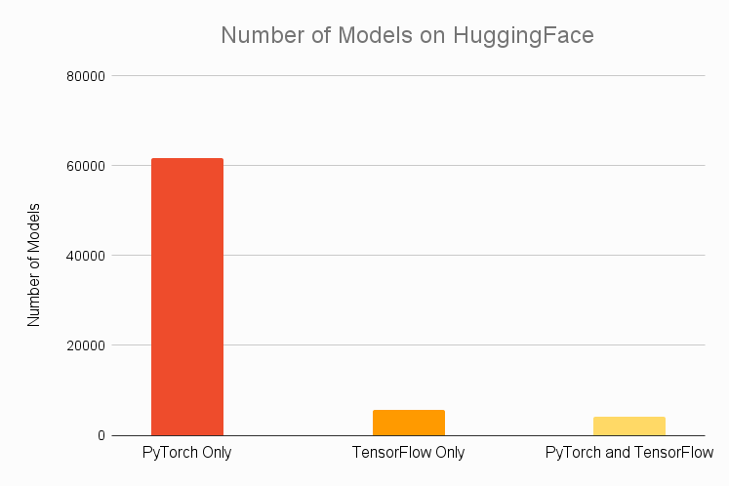
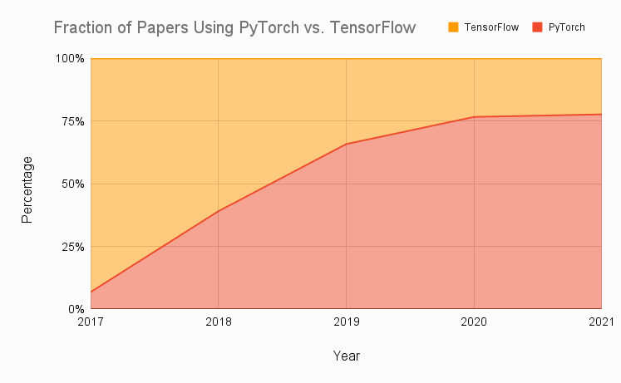
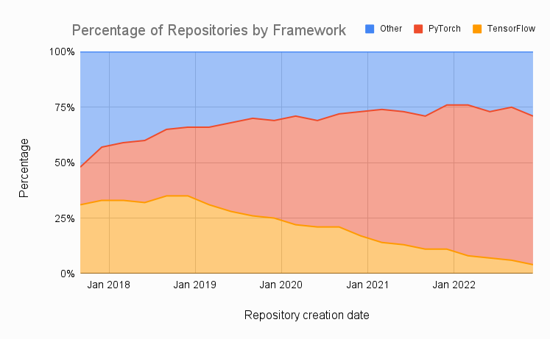
PyTorch Popularity
PyTorch is increasingly becoming popular in research area for the following reasons.
HuggingFace
92% of models on HuggingFace are PyTorch exclusive
Research Papers
Most of the recently published research papers use PyTorch
Papers with Code
It is a website that provides machine learning papers with code, almost 70% of them are implemented in PyTorch.

Slide 46

PyTorch vs TensorFlow
PyTorch
TensorFlow
Provides a Pythonic syntax and interface.
Offers flexibility for researchers to control the data movement.
Can make use of standard Python flow control.
Is popular in research area.
Need third party for visualization
Provides static computation graphs.
Offers high level interface for to build models.
Hard to make quick changes to the model.
Cannot make use of standard Python flow control.
More mature and preferred for production environment.

Slide 47
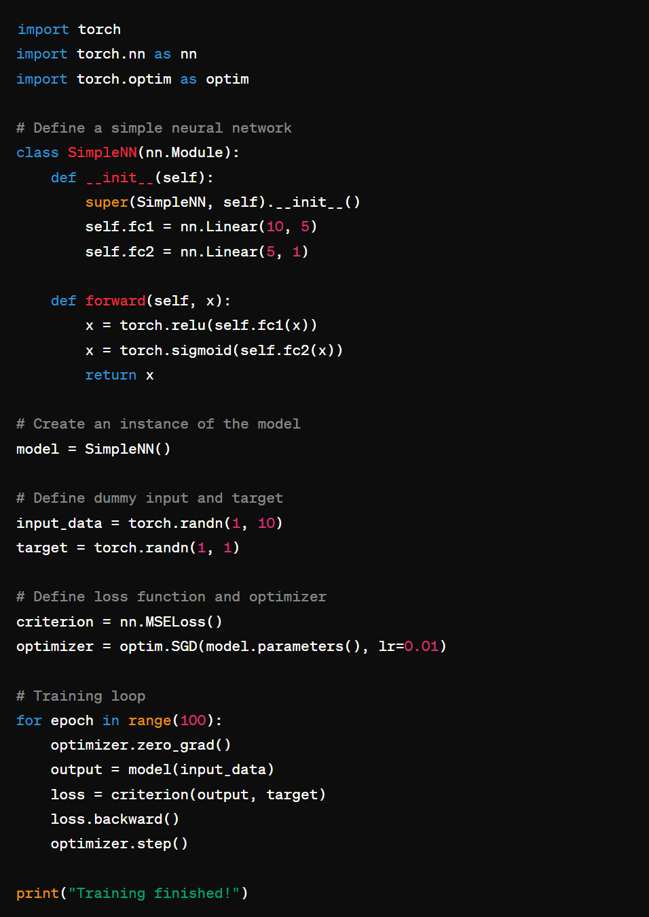
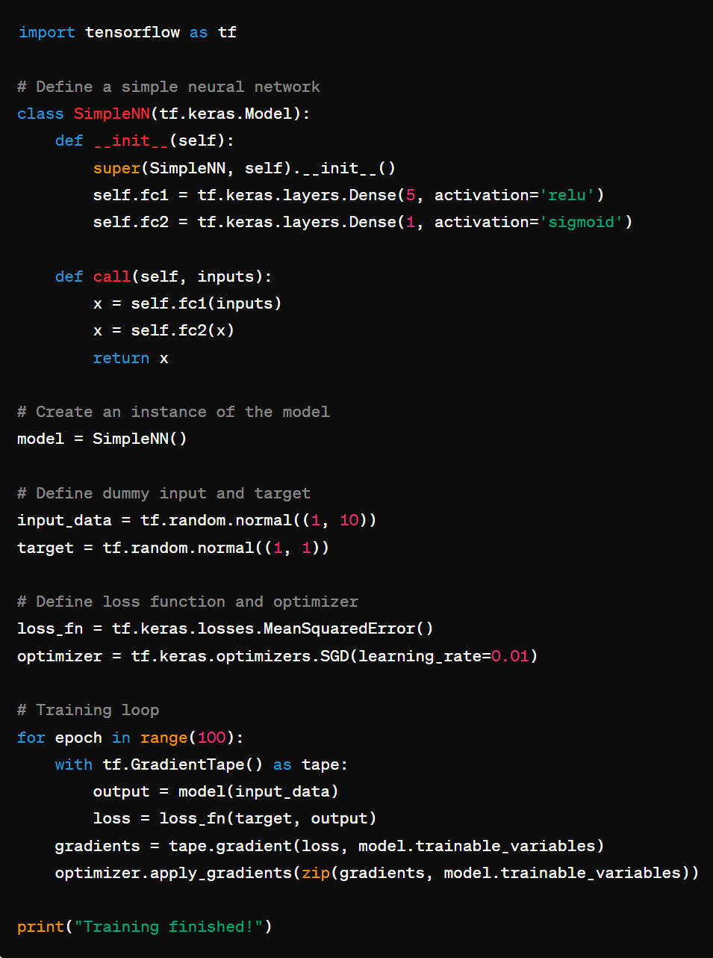
PyTorch vs TensorFlow
PyTorch
TensorFlow

Slide 48
Community:
A strong community encourages knowledge sharing, support, collaboration, and continuous improvement, driving the success and advancement of a technology.
François Chollet, the creator of Keras, actively engages with the community.
TensorFlow has one of the largest and most active communities in the deep learning ecosystem.
PyTorch is favored by many researchers for its flexibility, dynamic computation graphs, and intuitive design.
Islamia College,
Peshawar

Slide 49
THANK YOU

